Slide 1
Valentine’s Cup
CSE 496 Graduation Project 2
3rd Presentation
Yakup Talha Yolcu
Project Advisor: Doç. Dr. Mehmet Göktürk
June 2023

Slide 2
Contents
Project Definition
Project Design and Plan
Timeline
What is done so far?
Hardware Code
Screens
What could be done from now on?
Success Criterias
Resources and References

Slide 3
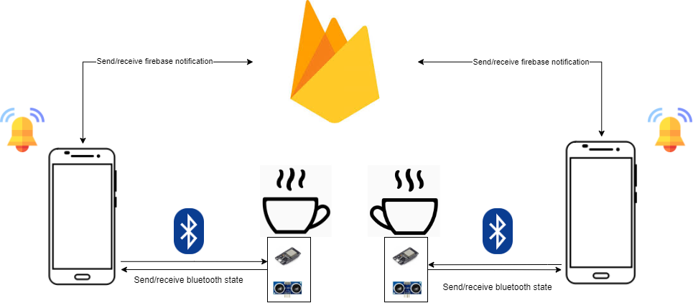
Project Definition
In this Project, there are two valentines connected to their individual cups via bluetooth.
When one drinks from their coffee, other Valentine’s phone plays a song.

Slide 4
Project Design and Plan
Each cup has ESP32, ultrasonic distance sensor underneath. ESP32 will connect the each phone via bluetooth. ESP32 will send the current state of the cup periodically.

Slide 5
Timeline
10.04-23.04 | 24.04-07.05 | 08.05-21.05 | 22.05-04.06 | 05.06-18.06
Getting ready hardware Creating mobile app project Creating firebase database | Making connection of app with database Communicate sides between each other Set up hardware without bluetooth | Complete bluetooth communication between hardware and phones | Run tests | Prepare cup view

Slide 6
What is done so far?
I got two ESP32’s, two ultransonic distance sensor and necesarry covers for two cups.
In the software side, we can see the incoming data from the hardware.
Designed screens are implemented, hardware code edited so that esp32 works efficiently. When app is closed, distance won’t be measured.

Slide 7
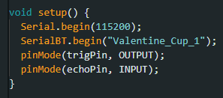
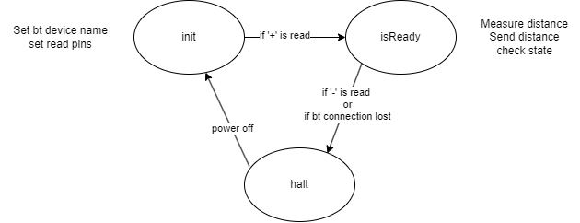
Hardware Code
void loop() {
digitalWrite(trigPin, LOW);
delayMicroseconds(2);
digitalWrite(trigPin, HIGH);
delayMicroseconds(10);
digitalWrite(trigPin, LOW);
duration = pulseIn(echoPin, HIGH);
distance = duration * 0.034 / 2;
int stopSignal = Serial.read();
if(stopSignal=='1') {
halt=1;
isReady=0;
}
else if(stopSignal=='2') {
halt=0;
isReady=0;
}
else {
if(halt==0) {
if(isReady==0) {
int readByte=SerialBT.read();
Serial.print("Read byte : ");
Serial.print((char)readByte);
Serial.print(" ");
Serial.println(readByte);
if(readByte=='+') {
isReady=1;
}
else if(readByte=='-') {
isReady=0;
halt=1;
}
else {
Serial.println("Read byte is not +");
}
}
else {
Serial.print("Distance is : ");
Serial.println(distance);
if(distance < 10) {
SerialBT.println("DOWN");
}
else {
SerialBT.println("UP");
}
int readByte=SerialBT.read();
if(readByte=='-') {
isReady=0;
halt=1;
}
if(SerialBT.connected()) {
}
else {
SerialBT.println("SerialBT not available");
isReady=0;
halt=0;
}
}
}
else {
Serial.println("Halted");
}
}
delay(100);
}

Slide 8
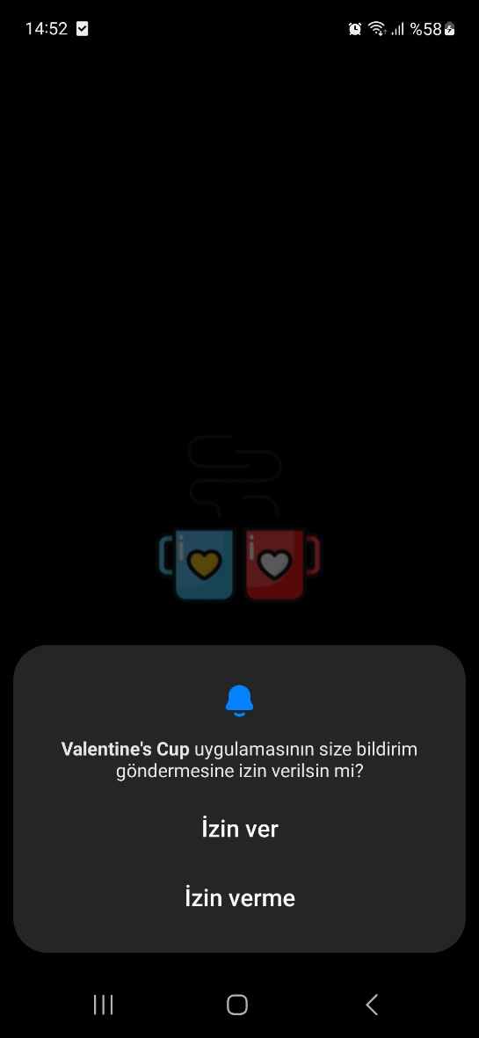
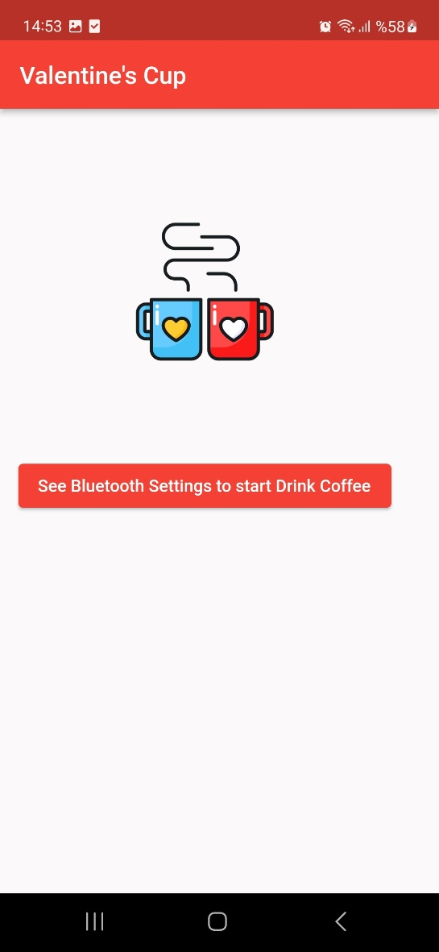
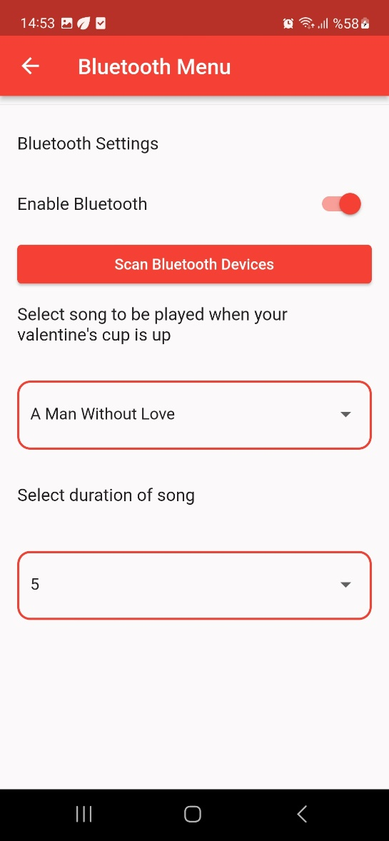
Screens

Slide 9
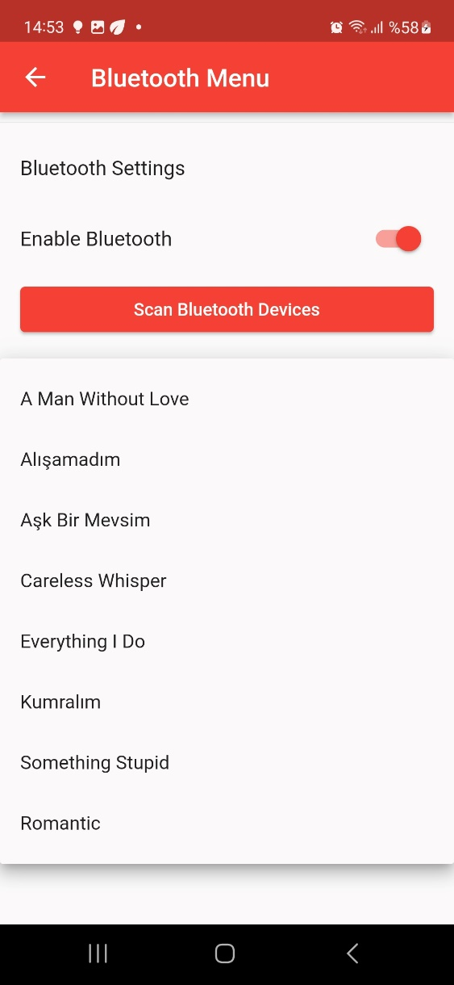
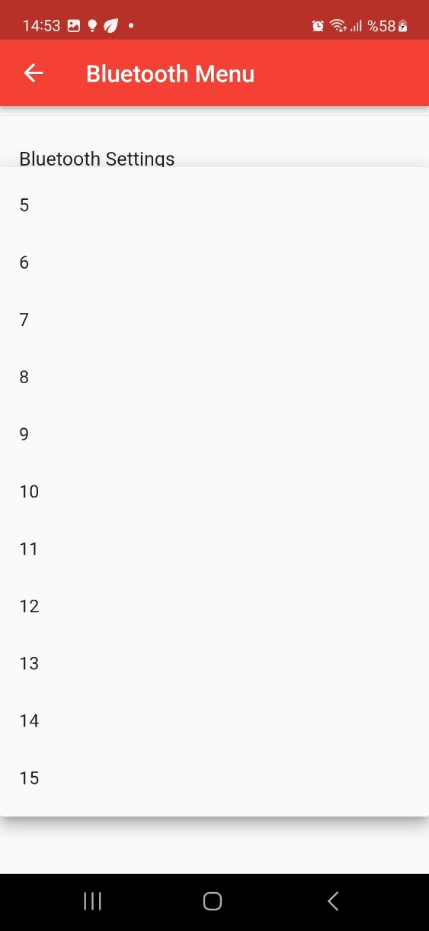
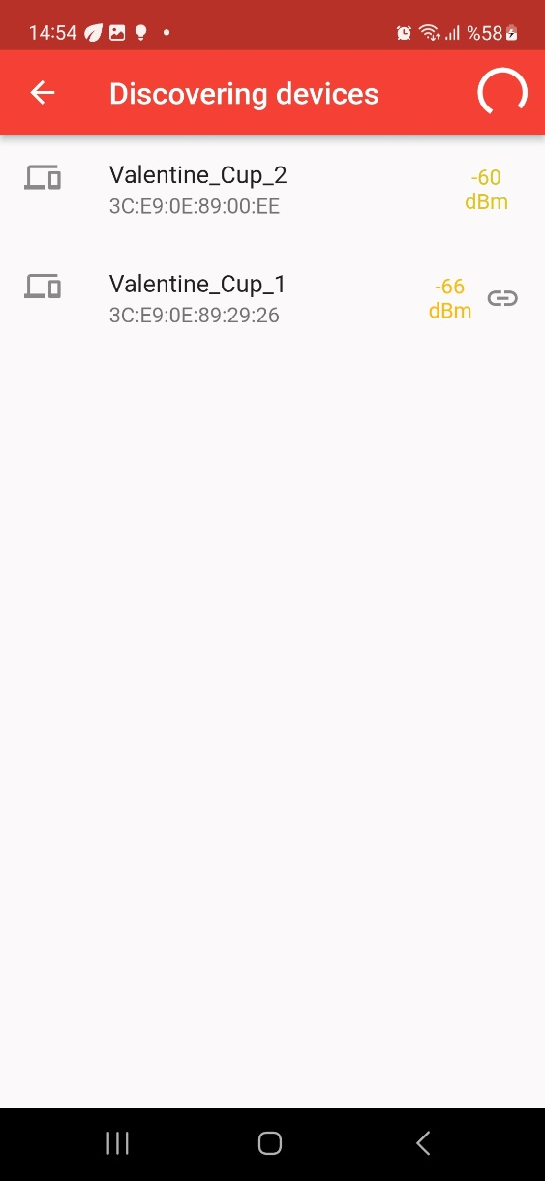
Screens – contd.

Slide 10
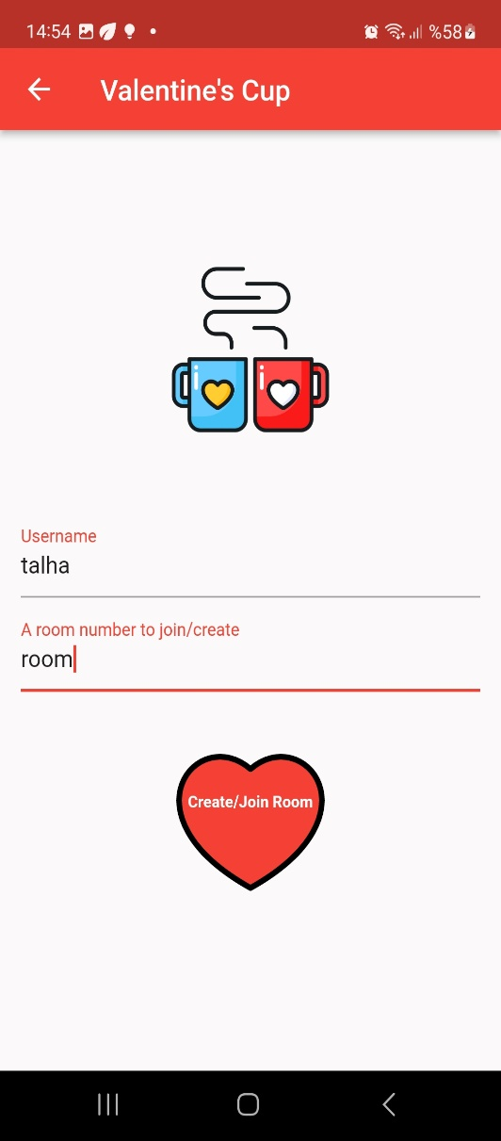
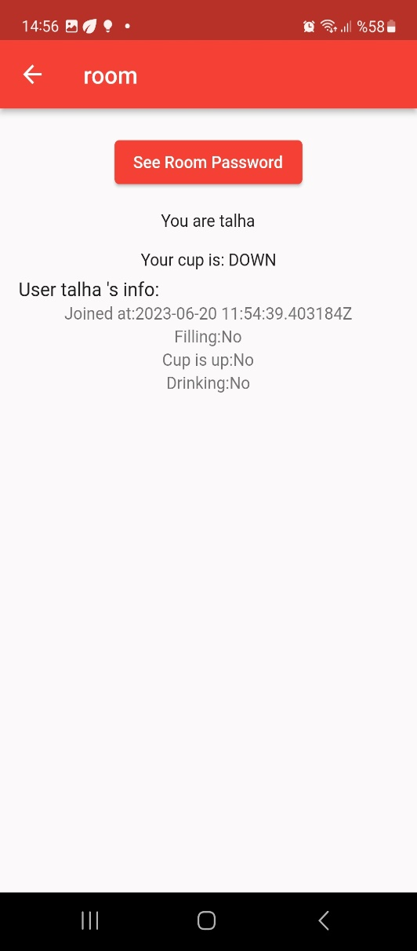
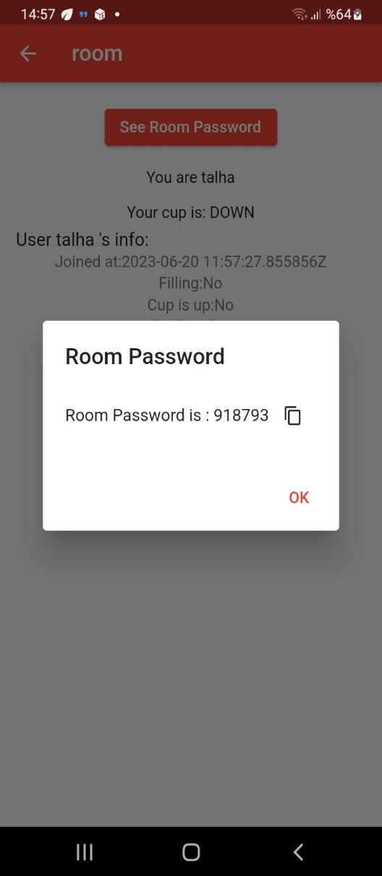
Screens - contd

Slide 11
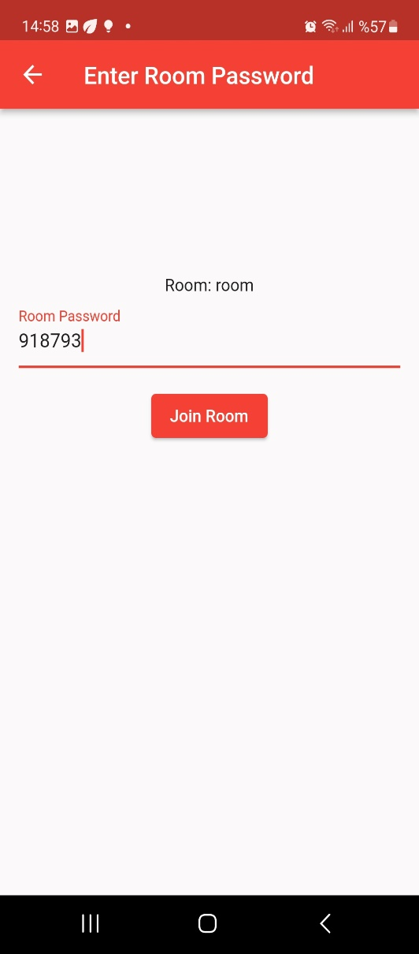
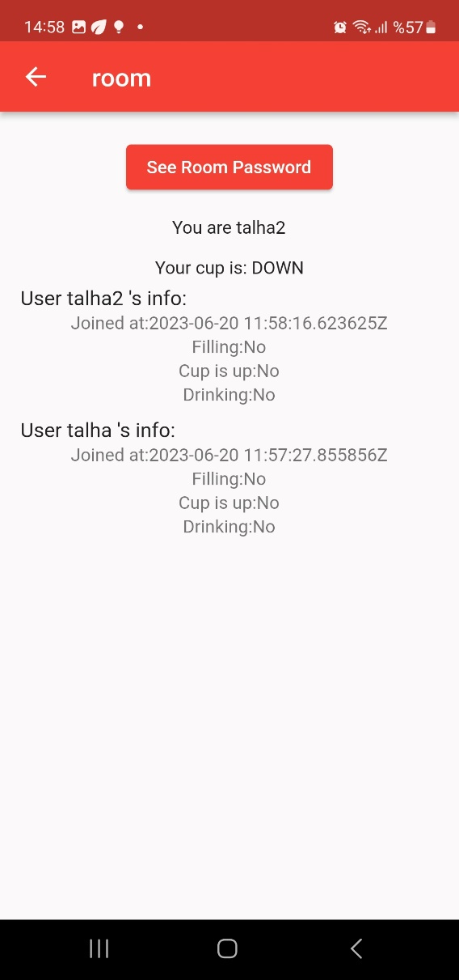
Screens - contd

Slide 12
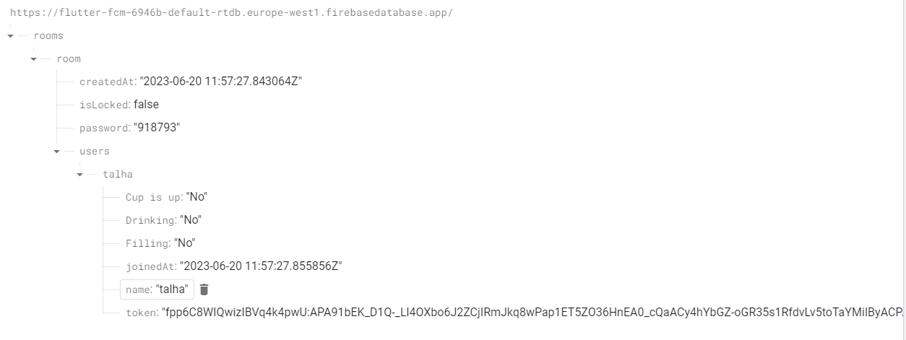
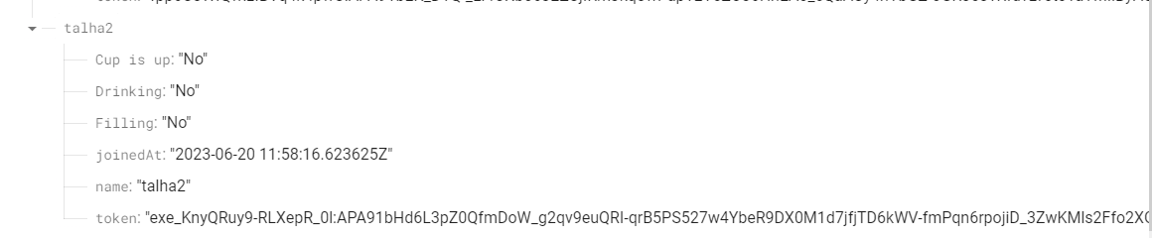
Server Side

Slide 13
What could be done from now on?
Music options can be selected from phones music library

Slide 14
Success Criterias
Sensor accuracy
Ultrasonic distance sensor must be accurate and provide reliable data to the ESP32, ensuring that the distance measurement is precise and consistent.
Bluetooth connectivity
The ESP32 must establish a stable Bluetooth connection with the phone and ensure that sensor data is transmitted accurately and in real-time.
Cloud messaging
The system must be able to send and receive notifications via Firebase Cloud Messaging.

Slide 15
Resources
https://www.robotistan.com/esp32-esp-32s-wifi-bluetooth-dual-mode-gelistirme-karti
https://www.robotistan.com/hc-sr04-ultrasonik-mesafe-sensoru
ESP32 – Ulrasonic distance sensor connection video
ESP32 – Bluetooth library video
Flutter_blue library for bluetooth connection
https://cdn4.iconfinder.com/data/icons/google-i-o-2016/512/google_firebase-2-512.png
https://upload.wikimedia.org/wikipedia/commons/thumb/d/da/Bluetooth.svg/1342px-Bluetooth.svg.png
Draw.io for designs

